Slide 1
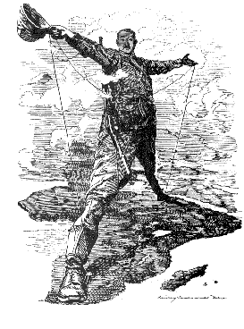
European Imperialism
European nations compete to control the pre-industrial world

Slide 2
Do Now
Examine the cartoon and answer the following questions:
Where is the man standing?
What do you notice about the man’s clothes?
Who do you think he is?
Why is he standing there?

Slide 3
From Cairo to Cape Town
Why would the British want to control Africa?
Why would industrialised European countries want to control other parts of the world?

Slide 4
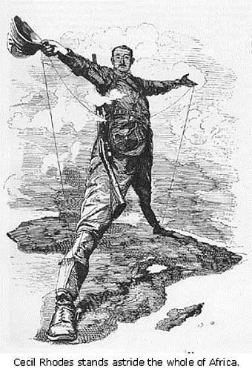
British Entrepreneur Cecil Rhodes
  “We happen to be the best people in the world, with the highest ideals of decency and justice and liberty and peace, and the more of the world we inhabit, the better it is for humanity.”

Slide 5
STANDARD:
The student will demonstrate knowledge of the effects of the Industrial Revolution during the nineteenth century by
a) explaining the rise of industrial economies and their link to imperialism and nationalism;
b) assessing the impact of European economic and military power on Asia and Africa, with emphasis on the competition for resources and the responses of colonised peoples.

Slide 6
What is imperialism?
A strong country extending its control over a weaker country (political, economic, or cultural control)
  *In the 1800s, many European countries began to compete with each other to gain control over less developed areas of the world
How might industrialisation have influenced Europe’s desire for more territory?

Slide 7
Answer
    Industrial Revolution led to:
      Need for resources to manufacture products
      Need for new markets in which to sell manufactured products
      Investment opportunities

Slide 8
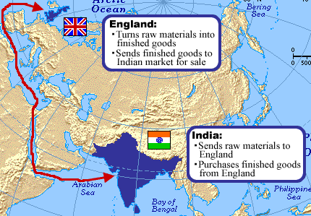
Which is the imperialist country?

Slide 9
Levels of Control
Direct Rule = sending officials from European country to run the country
Indirect Rule = governing the country through local rulers

Slide 10
Levels of Control:
Three Types of Imperialism
MOST CONTROL
Colonies
-Directly controlled by “mother” country
Protectorates
-Native ruler stays in power, but with foreign advisors
Spheres of Influence
-Foreign power claimed exclusive investment or trading privileges but did not rule the area
LEAST CONTROL

Slide 11
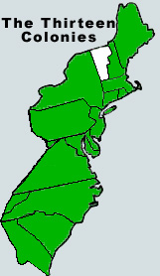
Colonies
Direct rule by one country over another
Replace local elites with officials from the mother country
Settlement colonies
vs.
Dependent colonies
Britain’s American colonies
are an example

Slide 12
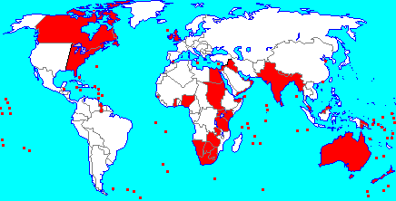
Britain
Largest empire
  “The sun never sets on the British Empire”
  Colonies were important for trading
  India was Britain’s most important colony at this time

Slide 13
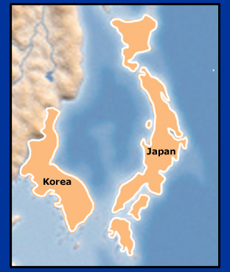
Protectorates
A country or region that is controlled by a more powerful country
Markets are only open to that country
Similar to mercantilist practices
Korea became a protectorate of Japan

Slide 14
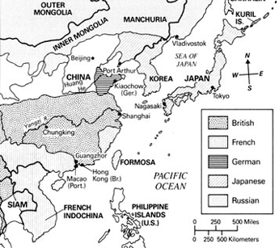
Spheres of Influence
Economically confined by a dominant nation
Territory keeps its own government
China up to 1914

Slide 15
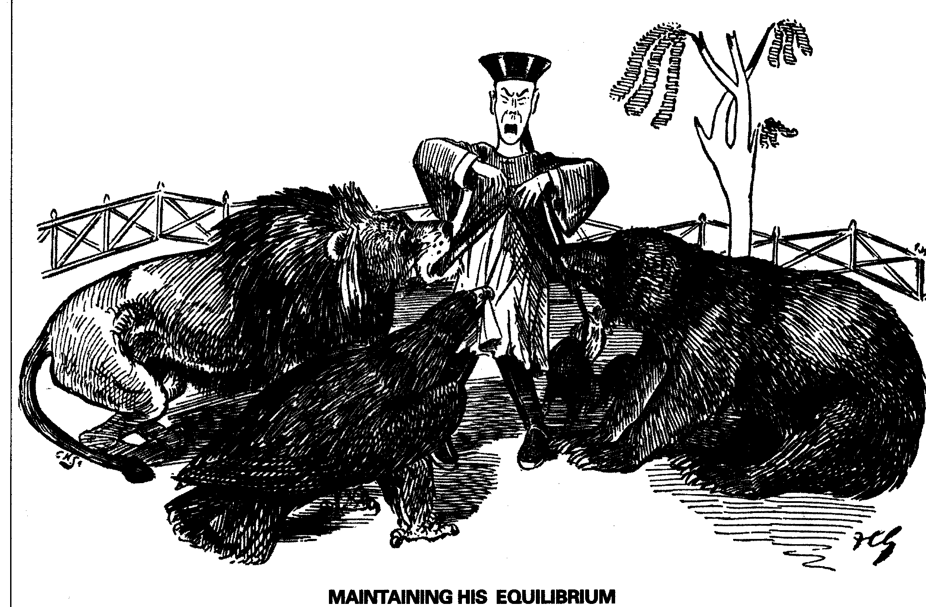
A political cartoonist’s view of spheres of influence in China
CHINA
BRITAIN
RUSSIA
U.S.A.

Slide 16
Imperialism:
Analysing European Motives

Slide 17
Do Now
What is imperialism?
Predict what you think some motives were for European Imperialism

Slide 18
Let’s look more closely at motives for imperialism...

Slide 19
Summary of motivations
Political
Economic
Exploratory
Religious
Ideological

Slide 20
Motives for 19th Century Imperialism
  Political
    Desire for power and prestige; Competition with neighbours; Nationalism; Expand territory and military
  Economic
    Industrial Revolution leads to need for resources AND new markets; Investment opportunities (expand and control foreign trade)
  Exploratory
    Adventure; Scientific knowledge; Seek the unknown
  Religious
    Spread Christianity; Protect missionaries; Moral education; Abolish slavery
  Ideological
    Cultural values: Whites are superior; Other cultures are primitive and need to be “civilised”; Racism; “Survival of the Fittest”

Slide 21
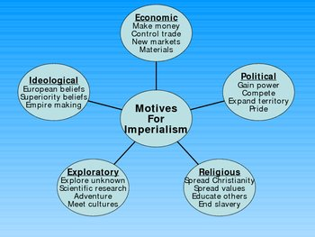

Slide 22
Objective
You will be able to analyse, identify and explain the political, economic, exploratory, religious and ideological motives of Europeans and their effects on indigenous people in Africa and Asia due to the demand of raw materials needed to fuel the Industrial Revolution and the want for exotic goods in Europe

Slide 23
Why are we doing this activity?
… in order to gain a deeper understanding of Imperialism and its effects on indigenous peoples in Africa and Asia.

Slide 24
Activity Directions
In this exercise you will be exploring the motives behind the European rush to create colonial empires at the end of the 19th century
Examine the placards:
  Describe what you see on the placard; it is ok to make guesses-talk it out with your partner
  Determine which of the five categories the artifact reveals; there may be more than one motive
  Choose one motive to fully explain

Slide 25
POLITICAL
POLITICAL motives were based on a nation’s desire to gain power, to compete with other European countries, to expand territory, to exercise military force, to gain prestige by winning colonies, and to boost national pride and security

Slide 26
ECONOMIC
ECONOMIC motives included the desire to make money, to expand and control foreign trade, to create new markets for products, to acquire raw materials and cheap labour, to compete for investments and resources, and to export industrial technology and transportation methods

Slide 27
RELIGIOUS
RELIGIOUS motives included the desire to spread Christianity, to protect European missionaries in other lands, to spread European values and moral beliefs, to educate peoples of other cultures, and to end the slave trade in Africa

Slide 28
EXPLORATORY
EXPLORATORY motives were based on the desire to explore “unknown” or uncharted territory, to conduct medical searches for the causes and treatment of diseases, to go on an adventure and to investigate “unknown” lands and cultures

Slide 29
IDEOLOGICAL
IDEOLOGICAL motives were based on cultural values such as the belief that the white race was superior, other cultures were “primitive,” Europeans should “civilise” peoples in other parts of the world, great nations should have empires, and only the strongest nations will survive

Slide 30
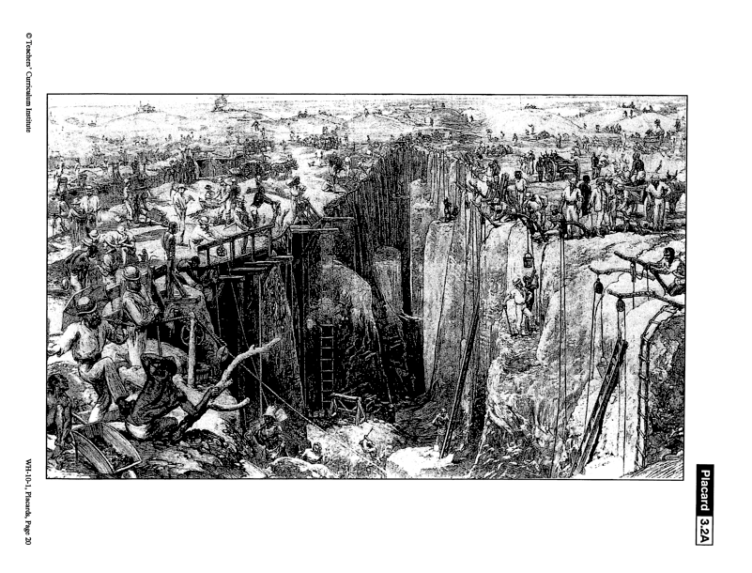

Slide 31
Placard 3.2 A
Open-shaft diamond mining at Kimberley, South Africa, in 1872
Imperial motives students might see here are:
Economic: African labor, exploiting natural
resources for profit
Ideological: Europeans treating Africans as inferior

Slide 32
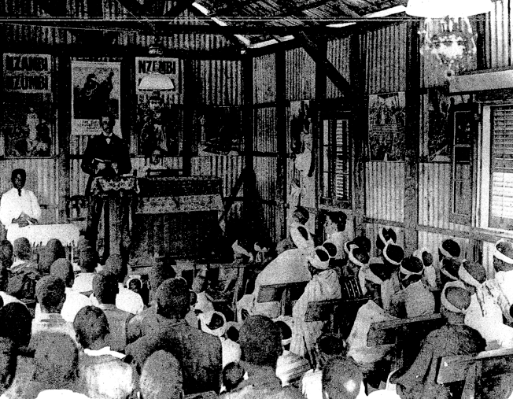

Slide 33
Placard 3.2 B
A Methodist Sunday School at Guiongua, Angola, 1925
Imperial motives students might see here are:
Religious: Europeans spreading Christian values and education
Ideological: teaching European customs and beliefs

Slide 34
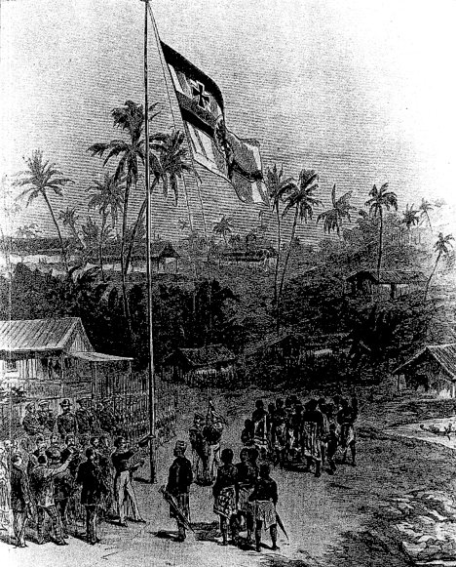

Slide 35
Placard 3.2 C
Germans taking possession of Cameroon in 1881
Imperial motives students might see here are
Political: flag shows national identity or desire to possess new territory, European and African leaders meeting, European military presence
Exploratory: exploring foreign lands

Slide 36
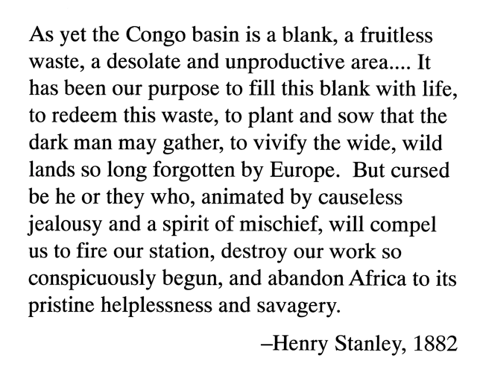

Slide 37
Placard 3.2 D
Quote from explorer Henry Stanley in 1882 – looking for the source of the Nile
An imperial motive students might see here is:
Ideological: belief in superiority of Europeans or that Europeans should “civilize” Africa

Slide 38
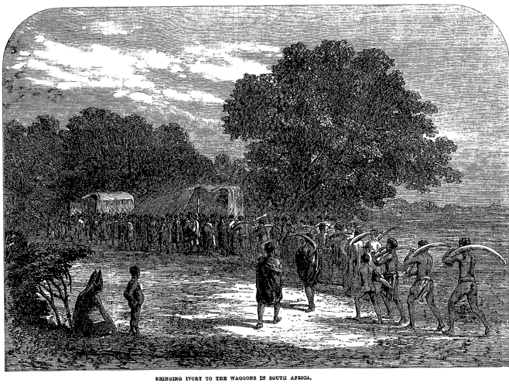

Slide 39
Placard 3.2 E
Africans bringing ivory to the wagons in South Africa, c. 1860
An imperial motive students might see here is:
Economic: collecting African resources
Ideological: European’s making Africans work

Slide 40
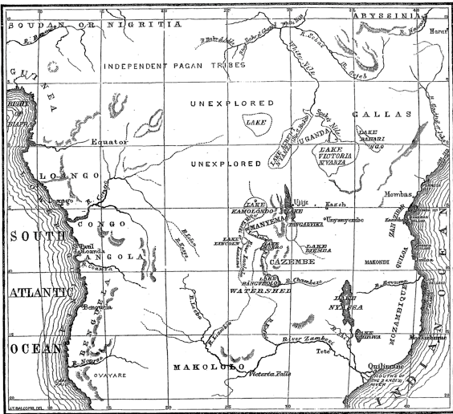

Slide 41
Placard 3.2 F
Sketch map of Central Africa, showing Dr. Livingstone’s exploration
An imperial motive students might see here is:
Exploratory: interest in unexplored territories, mapping geographic features of Africa
Dr. Livingstone’s goal was to find the source of the Nile River

Slide 42
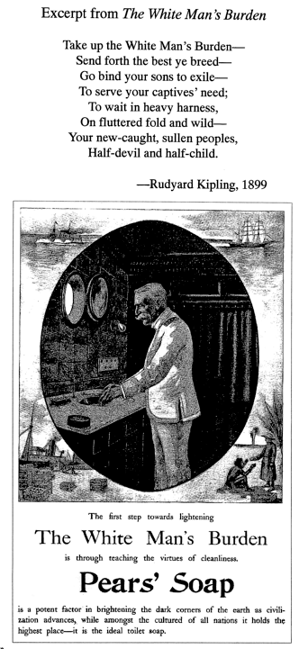

Slide 43
Placard 3.2 G
An advertisement for Pears’ Soap from the 1890s, and one stanza of the British poet Rudyard Kipling’s poem, The White Man’s Burden, written in 1899 in response to the American take over of the Philippine Islands
Imperial motives students might see here are:
Ideological: belief in European superiority, need to “civilize” captive peoples, need to cleanse “dark corners of earth”
Economic: boats transporting goods to colonies, advertisement to sell a product

Slide 44
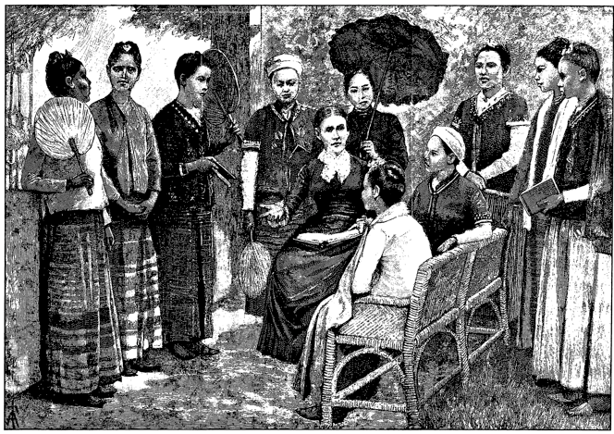

Slide 45
Placard 3.2 H
Mrs. Maria C. Douglas, doctor and missionary, and the first class of pupil nurses in Burma, in 1888
Imperial motives students might see here are:
Ideological: teaching European values
Religious: educating people of other cultures

Slide 46
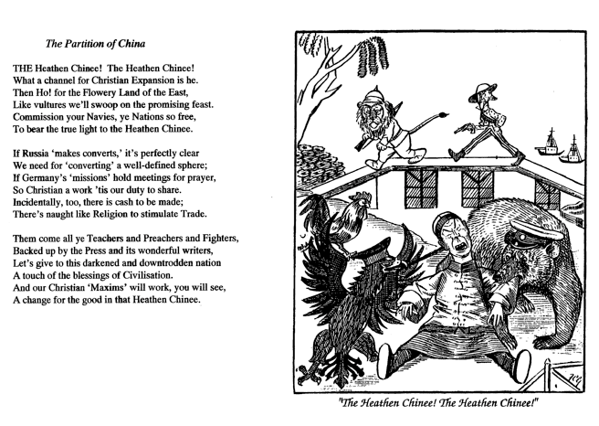

Slide 47
Placard 3.2 I
British cartoon showing the Chinese being savaged by European powers, and the poem The Partition of China, 1897
Imperial motives students might see here are:
Political: Europeans depicted as animals competing for piece of China
Economic: desire to trade in China to make cash
Religious: Chinese depicted as heathen, calls on Christian duty to preach in China
Ideological: belief that foreigners should be “civilized” by Europeans

Slide 48
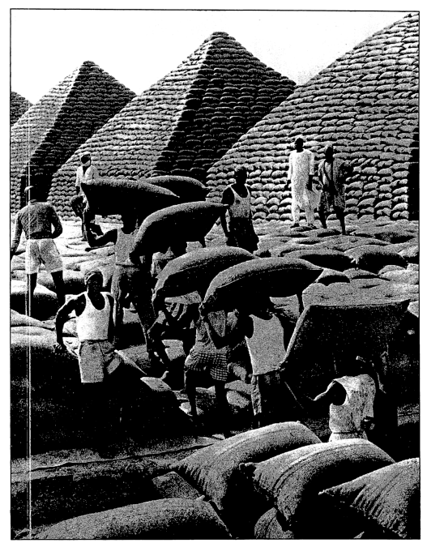

Slide 49
Placard 3.2 J
Bagged groundnuts in pyramid stacks in West Africa
An imperial motive students might see here is:
Economic: Africans transporting indigenous goods

Slide 50
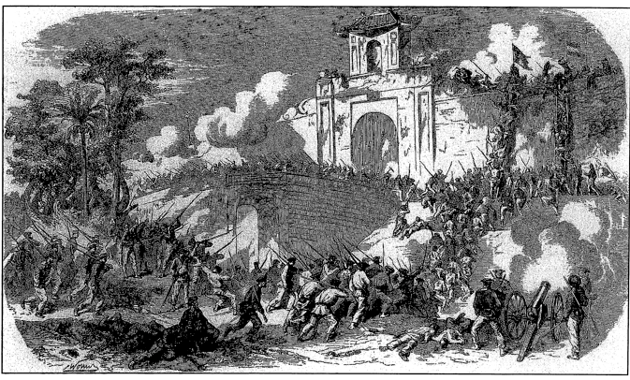

Slide 51
Placard 3.2 K
French capture of the citadel of Saigon, Vietnam
An imperial motive students might see here is:
Political: exerting military force, battling for possession of territory, carrying flags to establish political control

Slide 52
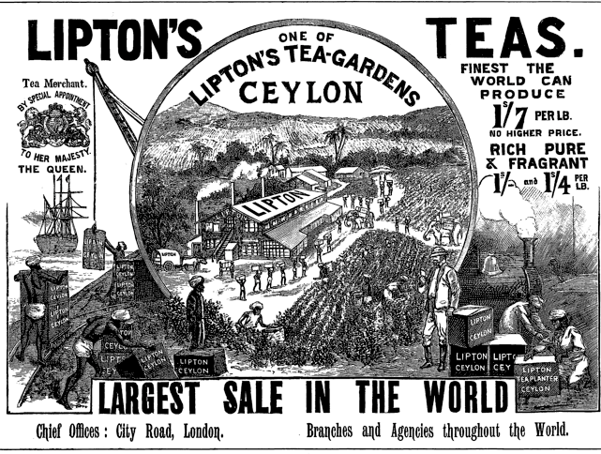

Slide 53
Placard 3.2 L
British Lipton Tea advertisement in the 1890s
Imperial motive students might see here are:
Economic: goods from Ceylon transported to London, use of indigenous labor and resources, exportation of industrial technology
Political: gaining national prestige through international trade

Slide 54
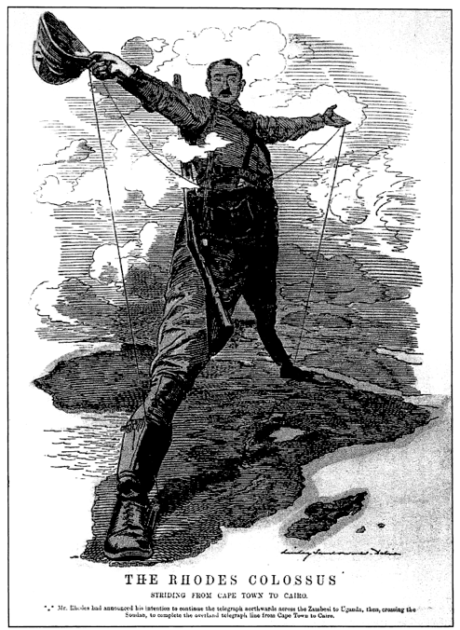

Slide 55
Placard 3.2 M
British cartoon “The Rhodes Colossus,” showing Cecil Rhodes’ vision of making Africa “all British from Cape to Cairo,” 1892
Imperial motives students might see here are:
Political: desire to control African territory, desire to boost national pride and gain power by winning colonies, desire to have military presence)
Exploratory: exploring or venturing into unknown territory

Slide 56
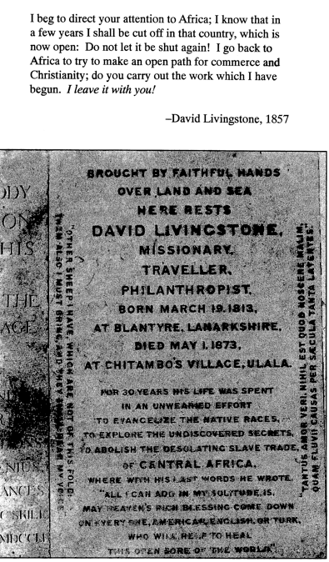

Slide 57
Placard 3.2 N
Epitaph and quote from missionary and explorer David Livingstone, the epitaph reads:
Brought by faithful hands over land and sea, Here rests David Livingstone, Missionary, Traveller, Philanthropist. Born March 19, 1813, at Blantyre, Lanarkshire. Died May 1, 1873, at Chitambo’s Village, Ulala. For 30 years his life was spent in an unwearied effort to evangelize the native races, to explore the undiscovered secrets, to abolish the desolating slave trade, of Central Africa, where with his last words he wrote, “All I can add in my solitude, is, May the Heaven’s rich blessing come down on everyone, American, English, or Turk, who will help to heal this open sore of the world.”
Imperial motives students might see here are:
Religious: missionary who spreads his faith, desire to abolish the slave trade
Exploratory: traveled to discover secrets of Africa

Slide 58
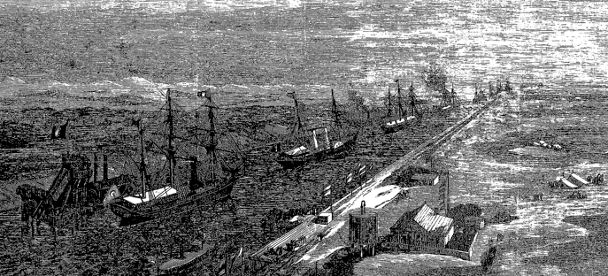

Slide 59
Placard 3.2 O
An imperial yacht passing through the Suez Canal in Egypt at the opening of the canal in 1870
Imperial motives students might see here are:
Economic: exportation of transportation methods to improve trade
Political: boosting national pride and prestige by controlling foreign territories

Slide 60
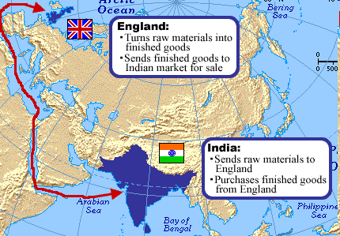
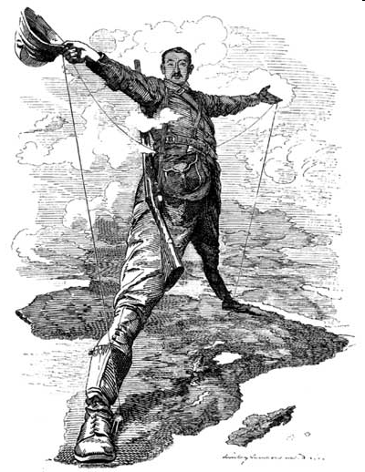
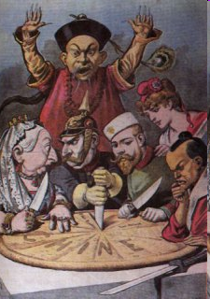
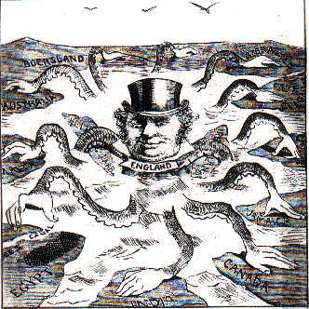
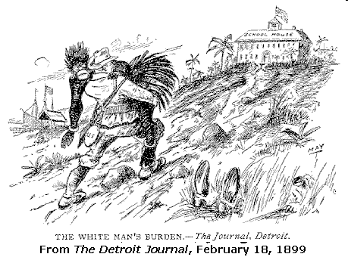
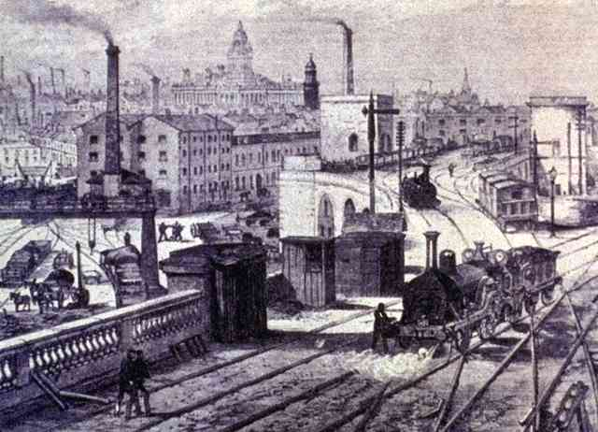
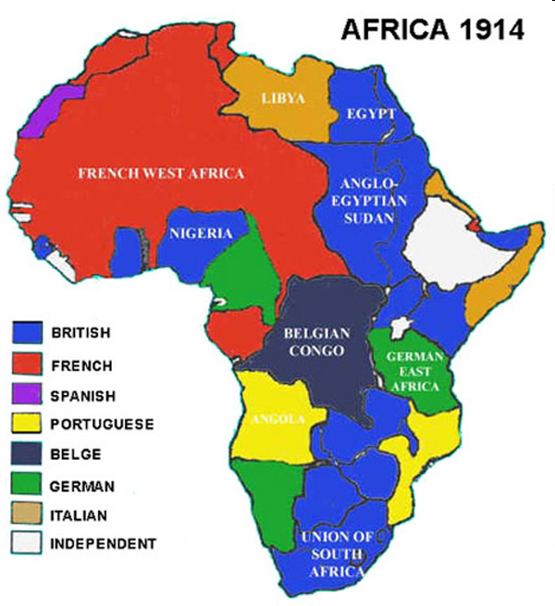
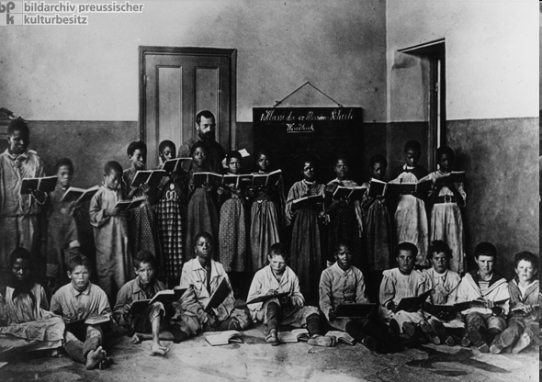
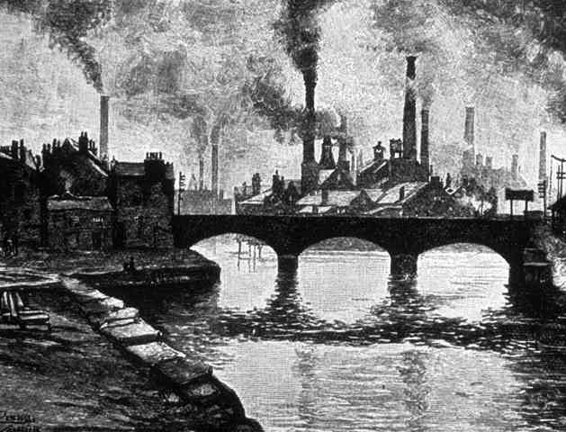
Match the motivation for imperialism to the picture! Use the Post-it notes!
1 | 2 | 3
4 | 5 | 6
7 | 8 | 9
Notes:
http://germanhistorydocs.ghi-dc.org/sub_image.cfm?image_id=1713 Christian missionaries were part of European colonization. When Germany acquired colonies, German missionaries went there to educate and Christianize the indigenous peoples in the name of German culture. Here is the first-grade class in a missionary school (elementary school) in Windhuk, Southwest Africa around 1910.

Slide 61
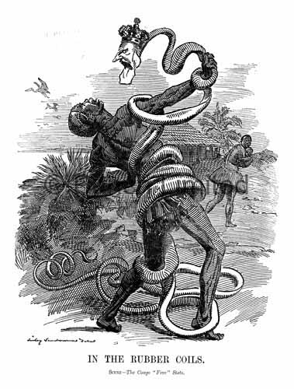
Resistance to Imperialism
Most colonized people strongly resisted Western expansion
  Some fought the invaders
  Some organized nationalist movements to expel the imperialists
Europeans had superior weapons and technology (e.g., machine guns, the telegraph, and riverboats)

Slide 62
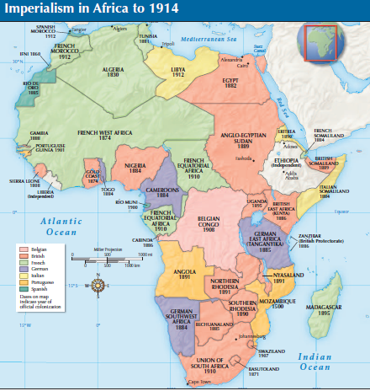
Scramble for Africa
1880 – Most of Africa consisted of independent states
1914 – With the exception of Ethiopia and Liberia, all of Africa was controlled by Europeans
History Channel:
http://www.youtube.com/watch?v=OJe1W_HIWmA&feature=related

Slide 63
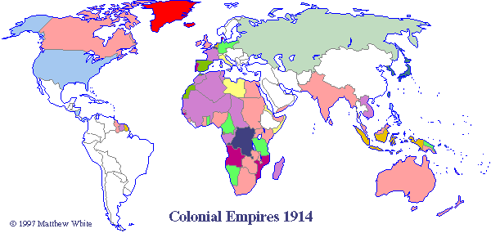
The Result of European Imperialism
http://users.erols.com/mwhite28/1907powr.htm

Slide 64
Why does it matter?
The economic, political, and social philosophies of Europe were spread around the world
The effects of 19th century imperialism still affect the world today
  Developed vs. developing countries (U.S. vs. Ethiopia)
  Modern day borders (Uganda/Tanzania border)
  Ethnic Conflicts (Rwanda Genocide)

Slide 65
Summary
Industrial nations in Europe needed natural resources and markets to expand their economies
These nations competed to control Africa and Asia in order to secure their own economic and political success
Imperialism spread the economic, political, and social philosophies of Europe throughout the world
Resistance to imperialism took many forms, including armed conflict and intellectual movements

Slide 66
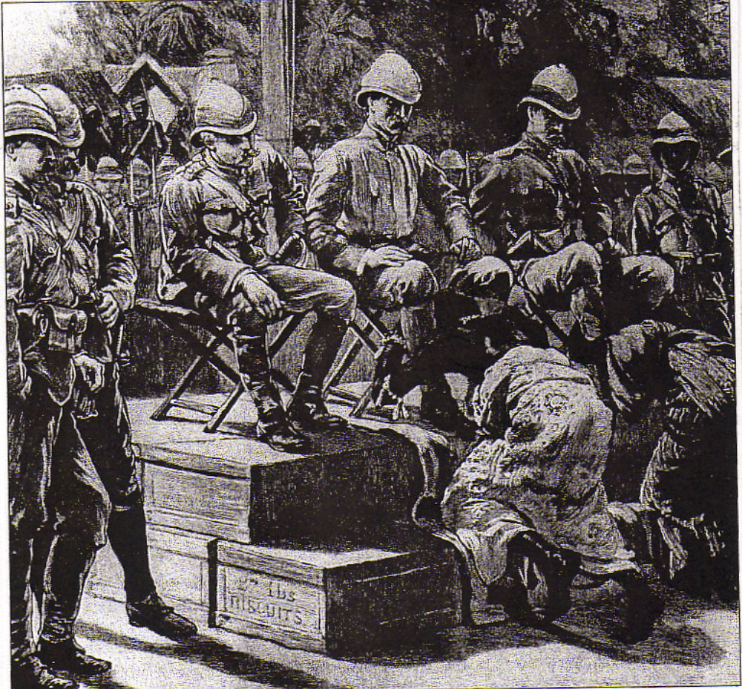
King Prempeh, ruler of the large West African Asante (Ashanti) state, formally submits to British officers in 1896. The Queen Mother
(on the right) also makes submission.
The British army occupied the Asante capital of Kumasi (in modern Ghana) in 1896. They forced King Prempeh to formally submit and then exiled him. What conclusions might be drawn about the power-relationships between the people shown?
Source: Alvin E. Josephy, The Horizon History of Africa (New York: American Heritage Publishing Co., 1971),
446.

Slide 67
Primary Source Analysis
Alexander Dalrymple, an official of the Admiralty and of the East India Company, wrote the following in the late 1700s. He was explaining why Liberty and Equality, watchwords of the American, French, and Haitian revolutions, could not apply to British-Indian relations:
Admit for a moment the possibility of communicating to the Indians the liberty we enjoy. The result of that liberty must be that force and elevation of mind which is so distinctive a part of the British character. ... Would the British with this spirit submit to foreign rulers? Granted his principles, he would not! And therefore making the Indians free, we expel ourselves from India.... A conquered people ... must still be slaves, however light the yoke; slaves can only be governed with despotic power ... and the Indians left to their own customs will enjoy perhaps all the liberty we can give them.

Slide 68
Some time ago a party of men came to my country . . . They asked me for a place to dig for gold, and said they would give me certain things for the right to do so. I told them to bring what they could give and I would show them what I would give. A document was written and presented to me for signature. I asked what it contained, and was told that in it were my words and the words of those men. I put my hand to it. About three months afterwards I heard . . . that I had given by the document the right to all the minerals of my country.
From Louis L. Snyder, ed., The Imperialism Reader, 1962.

Slide 69
The [Dutch government] compels [the Javanese farmer] to cultivate certain products on his land; it punishes him if he sells what he has produced to any purchaser but itself; and it fixes the price actually paid. The expenses of transport to Europe through a privileged trading company are high; the money paid to the chiefs for encouragement increases the prime cost; and because the entire trade must produce profit, that profit cannot be got in any other way than by paying the Javanese just enough to keep him from starving, which would lessen the producing power of the nation.
From Harry J. Benda and John A. Larkin, eds.,
The World of Southeast Asia: Selected Historical Readings, 1967.

Slide 70
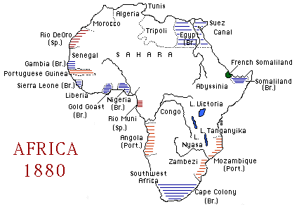
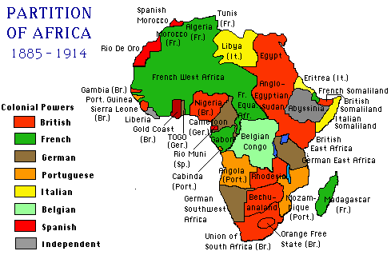

Slide 71
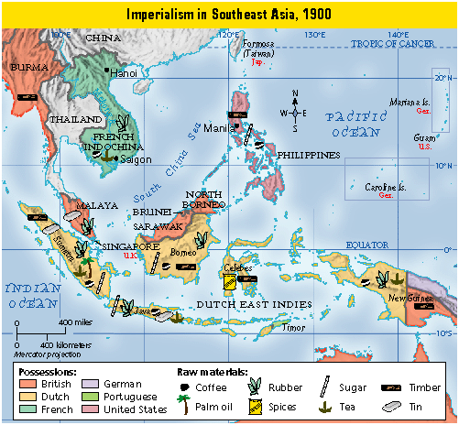

Slide 72
Costs & Benefits of Imperialism
How did native cultures benefit or suffer from imperialism? Given this reading and what you know, do you think imperialism is good or bad? Why?
Positives Negatives

Slide 73
Miscellaneous

Slide 74
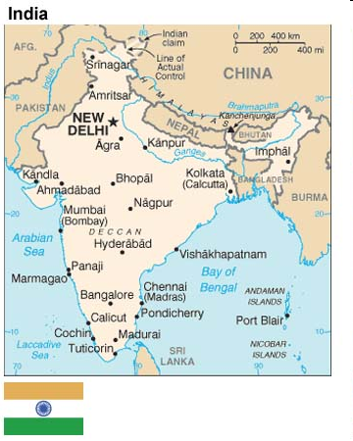
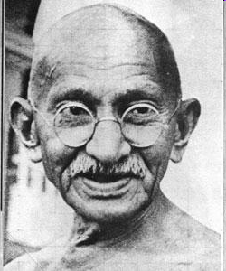
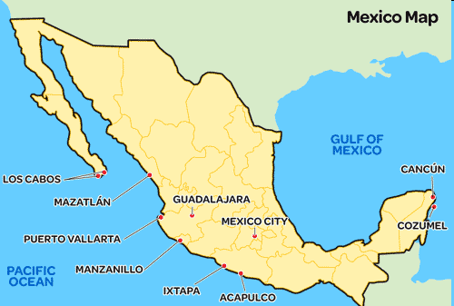
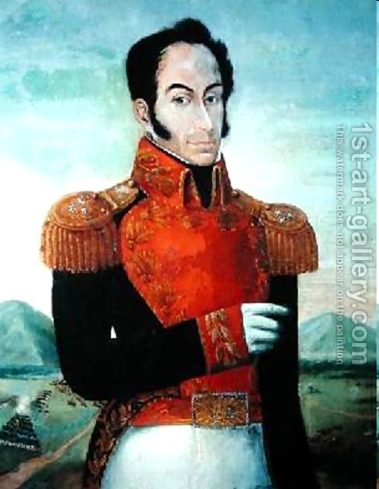
Vocabulary | People | Places | Miscellaneous
creoles | Jose de San Martin |  | Suez Canal
mestizos |  |  | Panama Canal
Indirect rule | Miguel Hidalgo | Congo | The Boer War
Indigenous |  | Philippines | Sepoy Mutiny

Slide 75
Resistance Movements Around the World
Posters!!!
Include
  Key People
  Events
  Why resist?
  How resists?
  Vocabulary

Slide 76
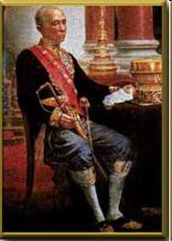
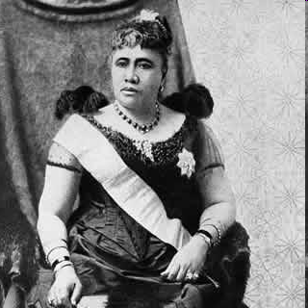
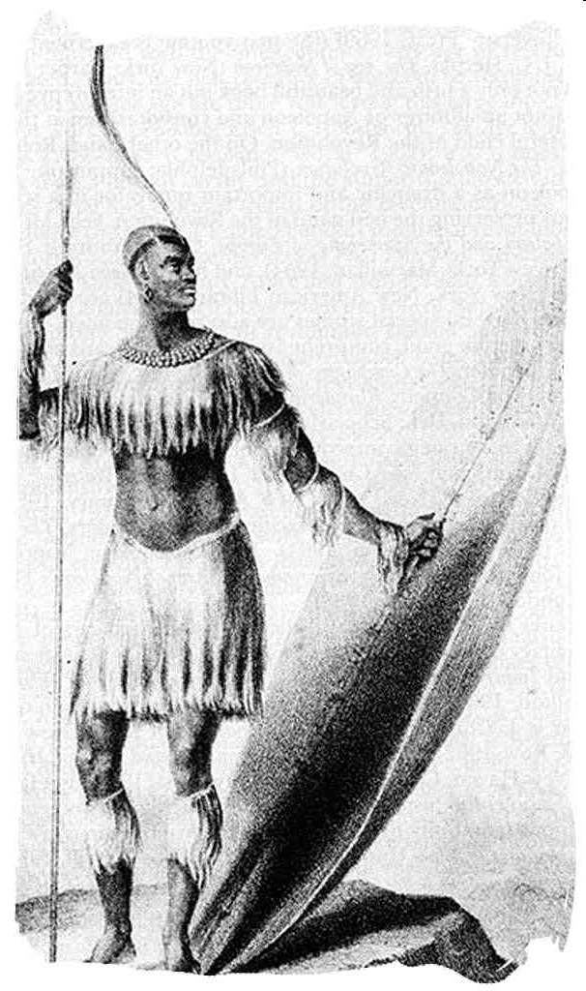
Faces of the Resistance
Choose a resistance leader and create a
“Facebook” page for them!
Use Ch. 14 in Glencoe or Chs. 11 and 12 in McDougal Littell for information about the person
Gandhi
Sun Yat-sen
Shaka Zulu
King Mongkut
Empress Dowager Cixi
Simon Bolivar
Muhammad Ali
Juan Vincente Gomex
Queen Lilioukalani

Slide 77
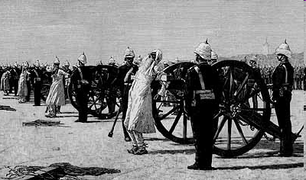
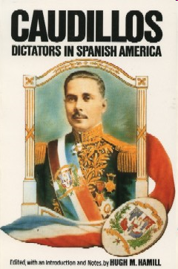
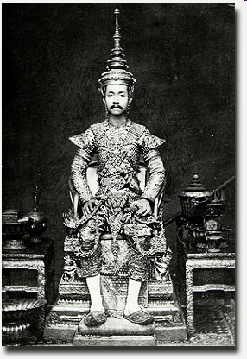


Match the resistance movement and country/region to the picture! Use the Post-it notes!
1 | 2 | 3
4 | 5 | 6
7 | 8 | 9

Slide 78
Quiz, Part 1
Directions: Match column A to column B
COLUMN A
Division of exclusive trading rights with China
Hay’s proposal to ensure equal access to Chinese markets
Members of a Chinese nationalist secret organization
Payment to the injured for damages
European freedom from Chinese law
COLUMN B
Spheres of influence
Extraterritoriality
Indemnity
Boxers
Open Door Policy

Slide 79

BCR
How did native cultures resist European imperialism? Use examples from at least 2 regions.
*topic sentence
*conclusion
*Min. 8 sentences
Indirect rule
Direct rule
Sepoy Mutiny
Self-strengthening
Extraterritoriality
Caudillos
Indian National Congress
King Leopold
Monhandas Gandhi
Sun Yat-sen

